Slide 1

CHECK IN CHECK OUT C-IN C-OUT

Slide 2




THE TEAM
IBM Mentor
Ms. Priya Kalra
Edunet Mentor
Mr. Ankur Mishra
Students Name
Mantu Rana
Sumit Singh
Madan H S
Mayank Pathak

Slide 3
WORKLOAD DIVISION
Contribution of each team member in project
Sumit Kumar Singh : Frontend / Backend Development / Database / Deployment
Mantu Kumar Rana : Backend Development / Database
Madan H S : Frontend Development / Resources
Mayank Pathak : Frontend Development / Documentation

Slide 4
THE BACKGROUND
Relied on fingerprints or iris scans.
Faced challenges like wear and tear of sensors and data privacy concerns.
Research into face recognition technology started due to the need for more secure and non-intrusive methods.
Businesses and public spaces used CCTV systems for basic people counting.
The pandemic increased the demand for contactless technologies.
Face recognition became widely adopted for attendance and automated people counting.

Slide 5
PROBLEM STATEMENT
The problem is to develop an automated, contactless face attendance system with real-time people counting to replace manual or basic biometric methods, improving accuracy, eliminating fraud, and enabling efficient monitoring of attendance and occupancy in environments like schools, offices, and public spaces.AI in Surveillance and Attendance Systems.

Slide 6
PROPOSED SOLUTION
The proposed solution is to create an AI-powered face recognition system integrated with real-time people counting. This system will automate attendance tracking and occupancy monitoring, using computer vision techniques for accurate, contactless operation. It will be deployed through an interactive platform like Streamlit, ensuring ease of use and real-time data processing for various environments such as schools, offices, and university & hospitals.

Slide 7
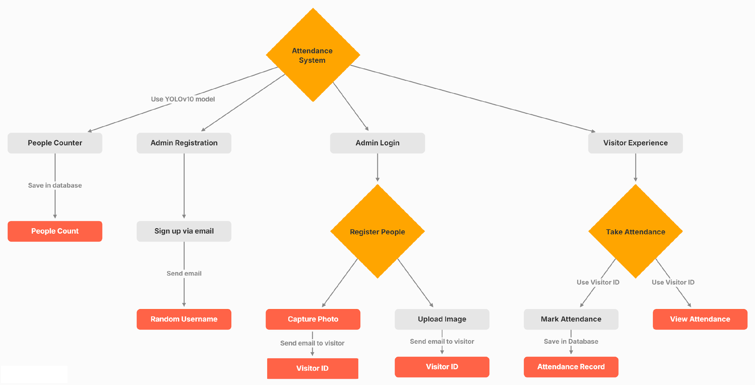
SOLUTION DESIGN

Slide 8
TECHNOLOGY STACK & REQUIREMENTS
OpenCV & YOLO: For real-time face recognition and accurate people counting due to their speed and reliability.
Streamlit: Chosen for fast deployment and creating an interactive UI with minimal effort.
Hardware: Minimum 8GB RAM, GPU , camera for video feed.
Software: Python, OpenCV, Tensor Flow, Pytorch, Yolo,Streamlit, and necessary libraries.
.

Slide 9

INNOVATIVE IDEA
Integrating real-time anomaly detection with face recognition and people counting.
Alerts administrators to unusual activities such as overcrowding or unauthorized access.
Enhances security and crowd management.
A self-learning AI model improves accuracy over time by adapting to environmental changes like lighting and angles, making the system more adaptable and precise.
Allows admins to log in and register based on their job roles in different organizations (Schools & Universities, Hospitals, Offices).

Slide 10
RESULTS / OUTCOMES / ANALYSIS
Contactless & Fraud-Free: Eliminates buddy punching and ensures hygiene.
Real-Time Monitoring: Provides instant attendance updates and people counting.
Scalability: Easily deployable across large campuses, offices, Hospitals, Schools & University.
Efficiency: Reduces administrative burden, saving time and effort.

Slide 11

LIMITATIONS
The system's accuracy can be affected by poor or inconsistent lighting, leading to missed face detections.
Partially obscured faces (e.g., by masks or objects) may not be recognized accurately, impacting attendance recording.
The system may mistakenly count or classify non-human objects as people in crowded environments.

Slide 12

FUTURE ENHANCEMENTS/SCOPE
Voice-Activated Attendance: Enable voice recognition for hands-free check-ins, especially useful in settings where touch is minimized (e.g., hospitals).
Mask Detection & Adaptation: Include the ability to recognize faces even when partially covered improving accuracy in post-pandemic settings.
Face Counting Integration: To accurately count the number of people in a given area by identifying and recognizing faces in real time. Detect and classify human activities (e.g., sitting, walking, standing) in real time using computer vision.
Mobile App Development : Provide employees and staff the ability to mark attendance using their mobile phones once they enter the premises or reach a certain geolocation, offering flexibility and enhancing user convenience.

Slide 13
GITHUB LINK HTTPS://GITHUB.COM/RAJPUTROCKSTAR/CINCOUT.GIT

Slide 14
THANK YOU

